Slide 1
Book Recommender System
Ami Parikh, Alisa Babikova, Hoang Nguyen, Josh Goldberg

Slide 2
Problem Statement
Design a book recommendation system for users based on data from the Book Crossing dataset
Predict ratings for books not yet read by a given user
Predict for a user based on the highest predicted ratings and implicit feedback

Slide 3
I want to read something new but I don’t know what! ☹ Background
User activities have shifted online
Recommending relevant items to users can help customer engagement and business go up
Amazon directly attributes an estimated 35% of sales to their recommender system
Sometimes inadvertently can lead to problems - How Target Figured Out A Teen Girl Was Pregnant Before Her Father Did
Analyzing a user’s actions in the context of their other actions reveals much more about the user than a simple static record
A rich user context has within it multiple intents at any point in time
Types of recommender systems
Memory-based Collaborative Filtering
User-based and Item-based using Cosine Similarity
KNN – supervised and unsupervised
Model-based Collaborative Filtering
SVD and the Surprise package
Learn-to-rank

Slide 4
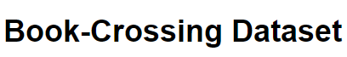
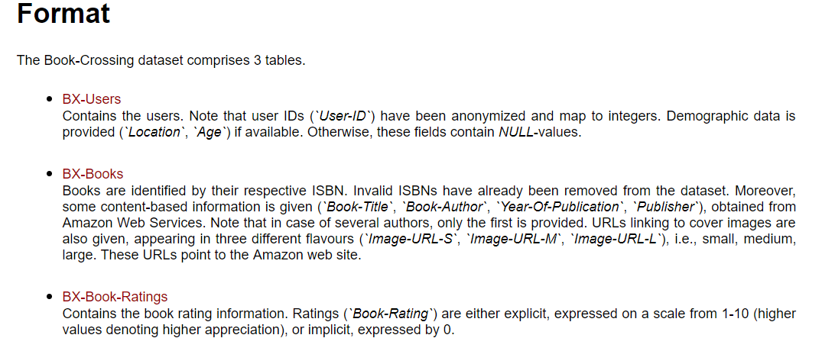
Who Read What? Data and Cleaning

Slide 5
Who Read What? Data and Cleaning
Users
Eliminated age <10 and >100
Split location into city, state, country
Books
Dropping rows with missing publication dates and publication dates after 2018
Replace missing publisher with “Other”
Ratings
Removed rows with an implicit book_rating of 0
Replace missing author with “Unknown”

Slide 6
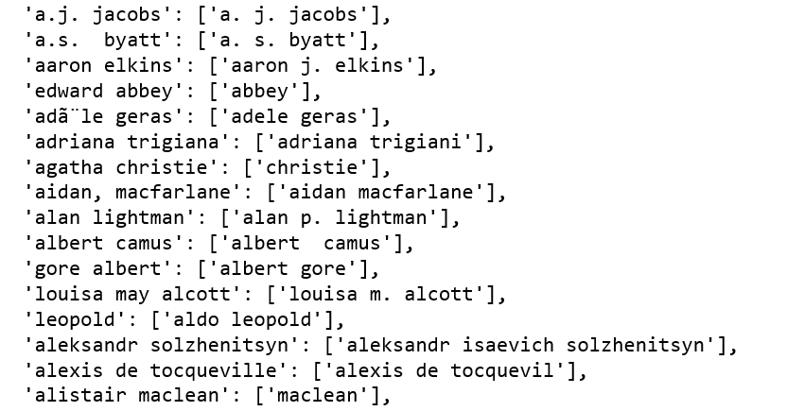
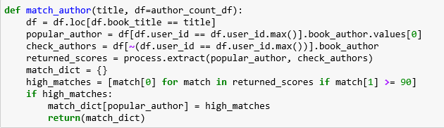
Who Read What? Data and Cleaning
Key Problems:
Duplicate ISBNs for same book due to different editions
Typos in author name

Slide 7
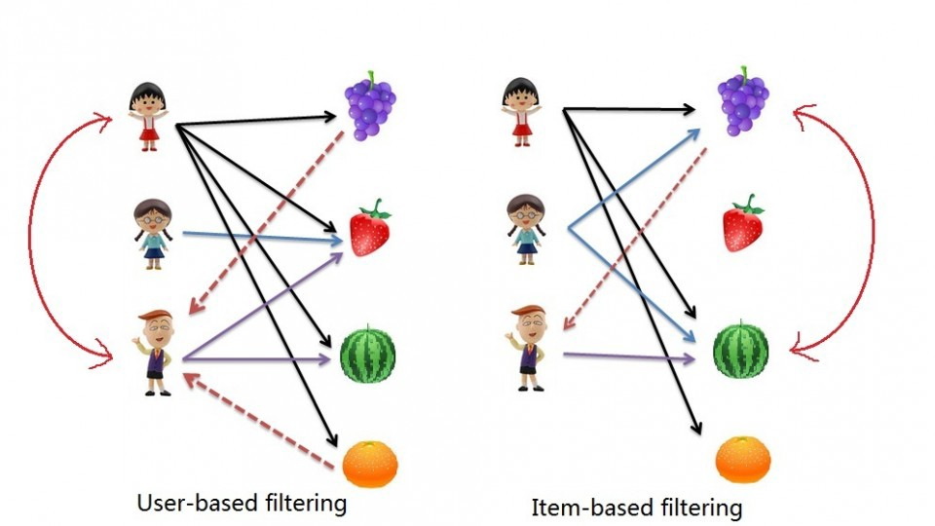
Memory-based Collaborative Filtering
This approach uses user rating data to compute the similarity between users or items
This is used for making recommendations. This was an early approach used in many commercial systems
The underlying assumption - if person A has the same opinion as a person B on an issue, A is more likely to have B's opinion on a different issue than that of a randomly chosen person
Represent dataset in a feature space- if two data are close to each other in terms of similarity, they should map to close points in the feature space

Slide 8
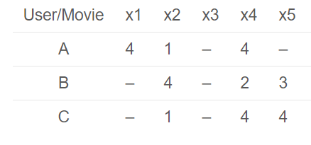
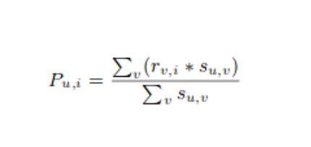
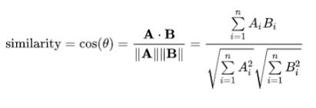
Memory-based Collaborative Filtering User-Based and Item-based using Cosine Similarity
Methodology
Matrix of users vs. items created
Cosine similarity between the users (or items) is calculated
The cosine similarity function the difference in angle between two article directions
This difference in angle is normalized to the interval [-1, 1], where 1 implies the same direction and thus perfect similarity and -1 the complete opposite direction and thus no similarity
Prediction of ratings calculated using similarity values
Recommendations are made using the top predicted ratings

Slide 9
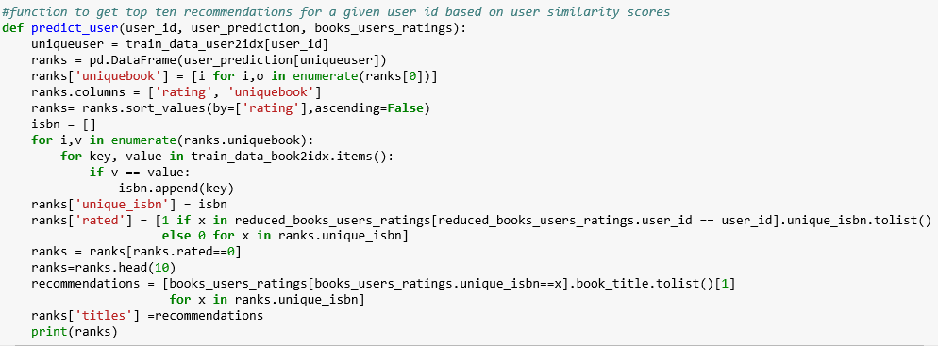
Memory-based Collaborative Filtering User-Based and Item-based using Cosine Similarity
Prediction function

Slide 10
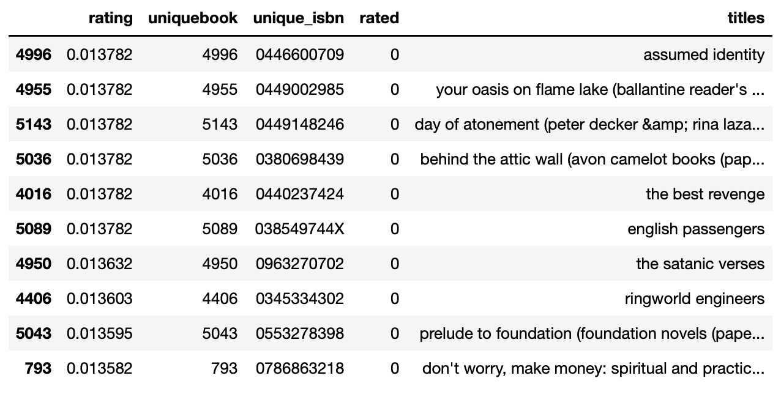
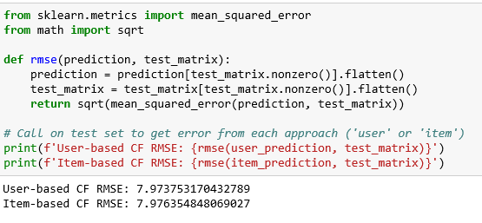
Memory-based Collaborative Filtering User-Based and Item-based using Cosine Similarity
Results

Slide 11
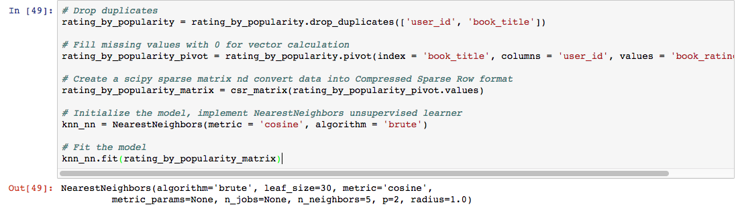
Algorithm – ‘brute’: use a brute-force search on a 2D matrix
Metric – ‘cosine’: cosine similarity between rating vectors
Memory-based Collaborative Filtering KNN – Method 1
KNN using NearestNeighbors (Unsupervised Searcher)
Neighbors-based classification is an instance-based learning or non-generalizing learning. It uses an entire dataset as for training and calculates Euclidian distances of new instances based, in this case, on ratings of books. This is achieved using a majority vote of the nearest neighbors of each point: a query point is assigned the data class which has the most representatives within the nearest neighbors of the point.

Slide 12
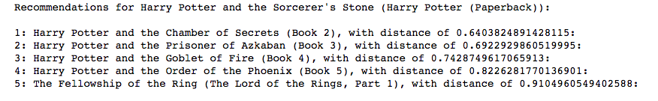
Memory-based Collaborative Filtering KNN – Method 1
Results
Recommendations based on a randomly selected observation, 5 nearest neighbors by Euclidian distance.
Prediction is made on book_title given user_id and ratings.
LOOCV and K-fold validation ➔ no train or test
Higher risk of overfitting

Slide 13
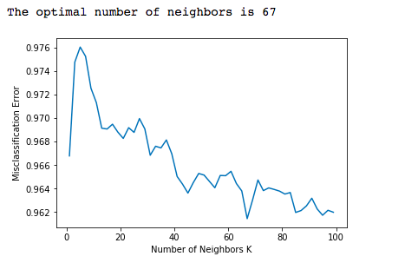
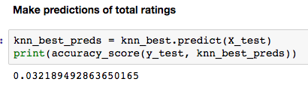
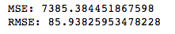
Memory-based Collaborative Filtering KNN – Method 2
KNN using KNeighbors (Supervised Searcher)
Use GridSearch to find the optimal k (=5)
Accuracy is low, RMSE and MSE is very high, mostly because we are predicting total ratings

Slide 14
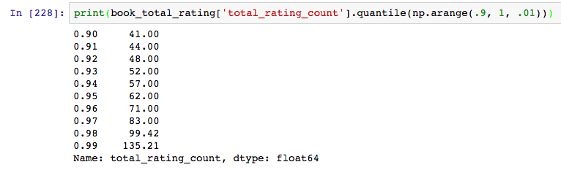
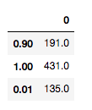
Memory-based Collaborative Filtering KNN – Method 2
Recommendations of total ratings => rating matrix
Top 1% matches the popularity threshold of 135 total ratings ➔ around 11,000 books

Slide 15
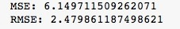
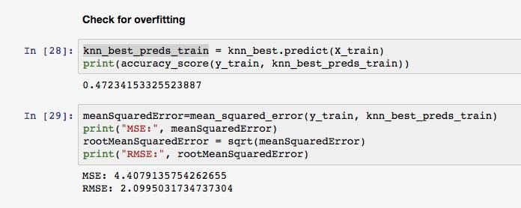
Memory-based Collaborative Filtering KNN – Method 2
Test and Train

Slide 16
Model-based Collaborative Filtering
Models are developed using different data mining, machine learning algorithms to predict users' rating of unrated items
Dimensionality reduction methods mostly used as complementary technique to improve robustness and accuracy of memory-based approach
Methods like singular value decomposition, principle component analysis, known as latent factor models, compress user-item matrix into a low-dimensional representation in terms of latent factors
Instead of having a high dimensional matrix containing abundant number of missing values we have a much smaller matrix in lower-dimensional space
Can be used for user-based or item-based neighborhood algorithms

Slide 17
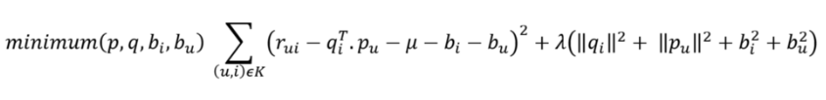
Model-based Collaborative filtering SVD
Matrix factorization technique that is usually used to reduce the number of features of a data set by reducing space dimensions from N to K where K < N
The matrix factorization is done on the user-item ratings matrix
Each item represented by vector `qi` , each user can be represented by a vector `pu`
Dot product of those 2 vectors is the expected rating
The goal is to minimise the square error difference between their dot product and the known rating in the user-item matrix
To avoid over-fitting and to reduce the error between the predicted and actual value, penalty and bias terms are added
The equation is minimised using SGD

Slide 18
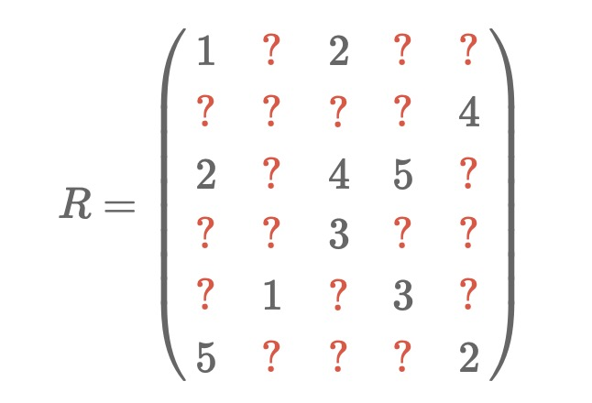
Model-based Collaborative filtering SVD
SVD is PCA on R (typical users) and R transpose (typical books)
SVD of R is not defined (M and U)
We can actually find the matrices M and U if we can find all the vectors pu and qi such that (the pu make up the rows of M and the qi make up the columns of UT):
Source: surprise package author: http://nicolas-hug.com/blog/matrix_facto_3

Slide 19
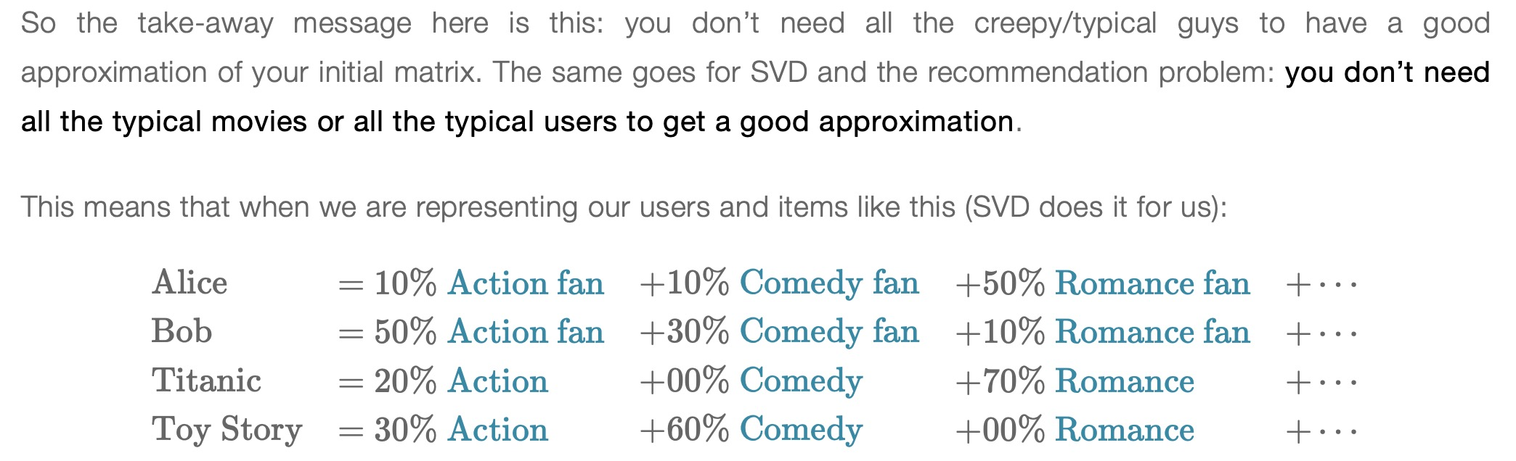
Model-based Collaborative filtering SVD
Eigen Vectors
Source: surprise package author: http://nicolas-hug.com/blog/matrix_facto_3

Slide 20
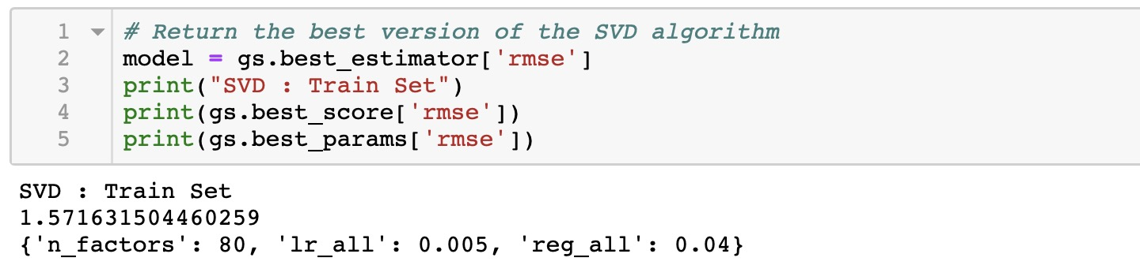
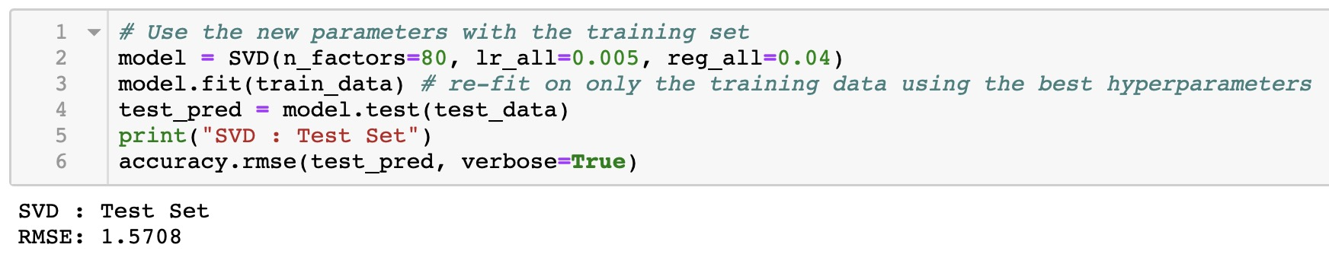
Model-based Collaborative filtering SVD
Training, Grid Search, Results

Slide 21
Model-based Collaborative filtering SVD
Comparing n_factors

Slide 22
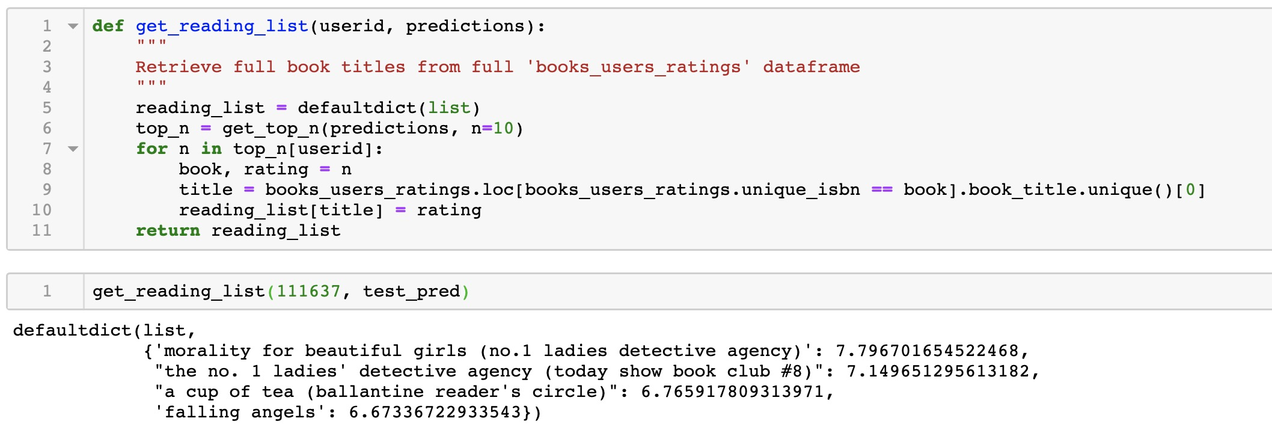
Model-based Collaborative filtering SVD
Book recommendations

Slide 23
Hybrid System
The Need
Kim Falk, Practical Recommender Systems, 2016

Slide 24
Hybrid System
The Approach
Monolithic Hybrid Recommenders:
Combine parts of different recommender systems
Mixed Hybrid Recommenders:
Union of all the results
Ensemble Recommenders:
Run full separate recommenders
Then combine individual results to yield final result
For example: 0.6 x collaborative filtering + 0.4 x content based model

Slide 25
Hybrid System
Focusing on explicit feedback (ratings) ignores the importance of the implicit feedback (choice of reading particular books)
Absence of rating does not equate absence of information
Absence of rating may mean higher probability of low ratings
Implicit vs. Explicit Feedback

Slide 26
Hybrid System
Learning to Rank
Focus on recommending most relevant items
Do away with need for rating prediction
Combine content based approach and “rating based” approach—Hybrid
Matrix Factorization of user and items features
Each feature has its own features (latent vectors)
Learn similarities among the side features
2 connected layers connected via dot product

Slide 27
Hybrid System
Optimization Algorithm
Select user u and item i that user has “liked” (positive item)
Select item j that is not liked (negative item)
Predict positive score and negative score
Feed score difference to a sigmoid function and use it as a weighting for stochastic gradient descent

Slide 28
Hybrid System
Used lifghtfm
~116K ratings, 10K users, 5K books
“Liked” = rating >= 6
Users must have read more than 5 books
Included book’s features ‘author’ and ‘earliest year of publication’
Did not include user’s features
Our Case

Slide 29
Hybrid System
Results
Number of users: 10717 Number of books: 4888 Sparsity: 0.174%
Train precision: 0.17 Test precision: 0.02
Train recall: 0.06 Test recall: 0.02
Train auc: 0.95 Test auc: 0.80

Slide 30
Hybrid System
Results
User 3 Known positives: the house at pooh corner, big stone gap cry, the beloved country brave new world; Recommended: the red tent, the no. 1 ladies' detective agency, lucky, i don't know how she does it
User 100 Known positives: winnie the pooh, the frog king the stranger, the no. 1 ladies' detective agency, lucky; Recommended: big cherry holler, don't let's go to the dogs tonight, murder on the orient express, lucky
User 499 Known positives: paris to the moon, cry, the beloved country, the lovely bones, the color purple, the joy luck club Recommended: the color purple x 5!
Maximimum p@k found: 0.03266 Optimal parameters: epochs: 9 learning_rate: 0.03589864099533542 no_components: 194 alpha: 0.00029244057400746806
Maximimum p@k found: 0.03593 Optimal parameters: epochs: 10 learning_rate: 0.023335810763701524 no_components: 182 item_alpha: 0.00047540242427134206 scaling: 0.0011719802747360935

Slide 31
Recommendations and Learning
More data would be nice
Data cleaning could be worked on more – we still see anomalies in spellings of authors names leading them to be listed as different authors
For recommender system as such, unsupervised NearestNeighbors would be able to make better predictions than supervised Kneighbors , though Kneighbors deal better with anomalies.
Working with implicit ratings – for this project we excluded implicit ratings and focused only on explicit numerical ratings

Slide 32
References
https://jessesw.com/Rec-System/
https://www.ethanrosenthal.com/2016/10/19/implicit-mf-part-1/
https://www.ethanrosenthal.com/2016/11/07/implicit-mf-part-2/
https://www.youtube.com/watch?v=EgE0DUrYmo8
https://lyst.github.io/lightfm/docs/index.html
Kim Falk, Practical Recommender Systems, 2016
https://www.analyticsvidhya.com/blog/2018/06/comprehensive-guide-recommendation-engine-python/
https://towardsdatascience.com/how-to-build-a-simple-recommender-system-in-python-375093c3fb7d
https://towardsdatascience.com/my-journey-to-building-book-recommendation-system-5ec959c41847
https://nycdatascience.com/blog/student-works/book-rating-prediction-recommendation-engine/

